Slide 1
CT026-3.5-2
Human Computer Interaction
Human Computer Interaction
Task Analysis
Level 2
Prepared by: RHR First Prepared on: December, 2007 Last Modified on:
Quality checked by: MOH
Copyright 2004 Asia Pacific Institute of Information Technology

Slide 2
Topic & Structure of the lesson
Task analysis
Hierarchical task analysis
  Task decomposition

Slide 3
Learning Outcomes
At the end of this lecture, you should be able to:
  Draft the Hierarchical Task Analysis (chart or textual based)

Slide 4
Key Terms you must be able to use
If you have mastered this topic, you should be able to use the following terms correctly in your assignments and exams:
Task analysis
Hierarchical task analysis

Slide 5
What is Task Analysis?
A method/set of methods for understanding the tasks users carry out with a product/system
About existing system/situation, not envisaging new systems/devices
Key definitions (Norman, 1988):
  Goal - the state that the human wishes to achieve
  Task - the activity required in order to bring about the state the human wishes to achieve (the goal)

Slide 6
Why Task Analysis?
Task analysis techniques support user-centred design
Informs us (in detail) as to:
  verifies that the set of actions employed by the user do to accomplish the task.
    Task analysis explicitly describes the procedure that the user actually employs since this may be different from the expected series of actions.
  To improve the delivery of information to the user.
    This involves identifying any problems with the delivery of information to the user and the consideration of possible solutions.
Can be used to:
  improve current design
  identify potential problems with new design
  identify requirements for new design
  design training materials and manuals
  develop evaluation plans
  conduct basic usability evaluations

Slide 7
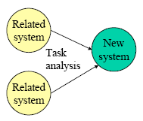

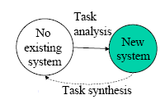


Task Analysis
Three potential ways to use of task analysis in the design process :

Slide 8
Hierarchical task analysis
HTA is a commonly used means of breaking tasks down into a hierarchy of goals, operations (actions) and plans
It involves breaking a task down into subtasks and then into sub – subtasks
Focus on physical and observable actions performed.

Slide 9
Procedure for carrying out
Hierarchical task analysis
The starting point is a user goal, then examined the main
tasks associated with achieving that goal. Where
appropriate, these tasks are subdivided into subtasks
Start with the overall goal (verb-noun pair), e.g. “Use email”, “Print a letter”
Break these down into meaningful subgoals/tasks (asking how question)
Break down subgoals further until reach an appropriate stopping point

Slide 10
Procedure for carrying out
Hierarchical task analysis
Add plans to the analysis - conditional statements, often utilising Boolean logic, e.g.
  DO 1, THEN 2, THEN 3, THEN EXIT
  DO 1, THEN 2, THEN (IF condition = true) DO 3,
  ELSE DO 4, THEN EXIT
In writing up plan for the HTA, there are type of plan that can be written up in the HTA, such as
    Sequence
      Eg: do 1.1 then 1.2 then 1.3
    Optional
      Eg: if the pot is full do 2
    Wait
      Eg: When kettle boil, do 4
    Cycles
      Eg: Do 5.1, 5.2 while there are still empty cups
    Parallel
      Eg: Do 1; at the same time ….
    Discretionary / Optional
      Eg: Do any of 1.3.1,1.3.2 or 1.3.3 in any order

Slide 11
Procedure for carrying out
Hierarchical task analysis
Represent the goals, subgoals, operations and plans which is the HTA using either:
  graphical representation - (boxes and arrows)
  non-graphical methods , text representation (e.g. tabulation, outlines, textual)

Slide 12
Hierarchical task analysis – textual representation
HTA can be written as a list like this:
0. to clean house
1. get vacuum cleaner
2. clean rooms
2.1 clean hall
2.2 clean living rooms
2.3 clean bedrooms etc
3. empty dust bag
4. put vacuum cleaner away
Plan 0: do 1,2,4 in any order
when dust bag full, do 3
Plan 2: do any of 2.1, 2.2, 2.3 in any order depending on which rooms need cleaning.

Slide 13
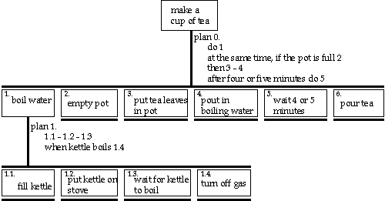
Hierarchical task analysis – graphical representation

Slide 14
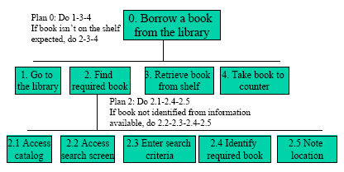
Hierarchical task analysis – graphical view
Can anyone detect the mistake at this graphical representation?

Slide 15
An example of complete HTA and analysis for a Microwave Oven activities
What is the overall goal?
  “Cook food!”
How is this done?
  Prepare meal
  Put meal in oven
  Select programme
  Listen for bell to ring
  Remove meal

Slide 16
An example of complete HTA and analysis for a Microwave Oven activities Cont..
Selecting a programme - How is this done?
  Set to autosensor
  Set to defrost
  Set timer to cook

Slide 17
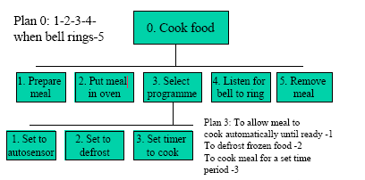
An example of HTA in graphical representation for a Microwave Oven Activities

Slide 18
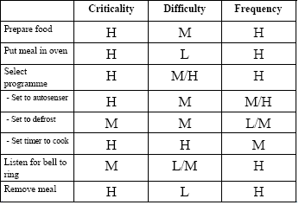
What does this HTA mean to the design? Further Task Analysis (Matrixes) - Analysis
H – High, M – Medium, L-Low
Notes:
task frequency - performed daily as it is main job task.
difficulty of learning - entry behavior requires computer, web, and design skills.
importance to train - low as a qualified person can probably be hired
task criticality - 5 on a scale of 1 to 5
task difficulty - 4 on a scale of 1 to 5

Slide 19
Task Analysis – Critical Thinking
Some requirements that might have ‘emerged’ from carrying out this Task analysis:
  The need for a distinctive, but not annoying, bell sound
  The need for an easily accessible mechanism for opening the door
  The need for a highly learnable (guessable) means of selecting a programme

Slide 20
Summary of Main Teaching Points
Information for task analysis can be drawn from existing documentation, observation of workers doing the tasks, or from interviews with workers and domain experts.
This can guide the choice of functionality and the objects and actions implementation within the system

Slide 21
Question and Answer Session
Q & A

Slide 22
Next Session
Topic and Structure of next session
Prototype
Notes:
Proceed with giving the students the task for their second tutorial (finding badly design product) as they are to present their work in the next tutorial session

Slide 23
Tutorial Q1
Your team has been asked to develop a student attendance system for a private college which deals with updating new attendance, modifying attendance, generating attendance list and viewing of attendance list. Produce a Hierarchical Task Analysis (HTA) in a form of chart or textual notation for any of the processes of your choice from the above scenario. In your answer, state clearly the processes involved and any assumptions that you have.

Slide 24
Tutorial Q2
You are required to develop an e-learning system for you campus. This system will be used mainly by the student and the lecturer in order to facilitate communication between them. In the system, the user can access to the notes, timetable, news, announcement and etc whereby the lecturer mainly used the system to upload all the learning material to be access by the student. Provide a Hierarchical Task Analysis (HTA) in a form of chart or textual notation for any of the processes of your choice from the above scenario. In your answer, state clearly the processes involved and any assumptions/s that you might have.

Slide 25



Some requirements that might have ‘emerged’ from carrying out this Task analysis:
  The need for a distinctive, but not annoying, bell sound
  The need for an easily accessible mechanism for opening the door
  The need for a highly learnable (guessable) means of selecting a programme

